Slide 1
Food Giant Flyer Generator
Kendrick Hagerman
Computer Science Project - COT6931
Notes:
Hello, I’m Kendrick Hagerman and this is my PowerPoint Presentation for my Capstone, the Food Giant Flyer Creator
This is for COT 6931
I am going to describe the work that went into creating my design for this program

Slide 2
Overview
Background
Discussion of Problem Domain and Initial Client Requirements
Flyer Example
Initial Steps
Beginning of Design
How Requirements changed during development
Technologies decided on
Refinement of Design
Software Design Document
Prototype Source Code
Brief Prototype Demonstration
Summary
Notes:
This is my presentation overview, I’ll keep this quick so we can start getting into the presentation
Project Definition

Slide 3



Background
Project is for the Food Giant
Problem came up when talking about work with friend
Stores have issue with excess inventory
No way to quickly promote store-specific sale items
Notes:
This project is for the Food Giant grocery store chain
“Food Giant actually consists of multiple grocery stores, Food Giant, Piggly Wiggly, Pic N Save, Mad Butcher, Save Mart, and Citronelle Markets
They also cover 8 states” – Reference http://www.foodgiant.com/locations
During a talk with a friend of mine, who is a district manager at Food Giant, he mentioned his company had tried to work with a third-party tech firm to get an application developed, but it fell through
I ended up talking to him about what the application needed to do, and decided on completing it for my Capstone Project
This project’s objective is to allow store managers at food giant to create and distribute customized sale flyers for excess goods to help sale them. This is to both reduce the cost of eliminating excess inventory before it loses the company income by becoming expired goods and earn more revenue for the store .
This problem will be solved by creating a Graphical User Interface (GUI) program designed for District and Store Managers.
The program, named the Food Giant Flyer Creation program, will allow these Managers to generate customized flyers for their store that they can print and distribute to customers.
Currently, they have no way to create flyers in this fashion. The only way customers can find out about store-specific sales is to be at the store.
These custom flyers will allow a store to more easily reach and inform their customer base about sales, which should draw in more customers, potentially increasing revenue.
This program is designed for Managers with very little experience with computers.

Slide 4
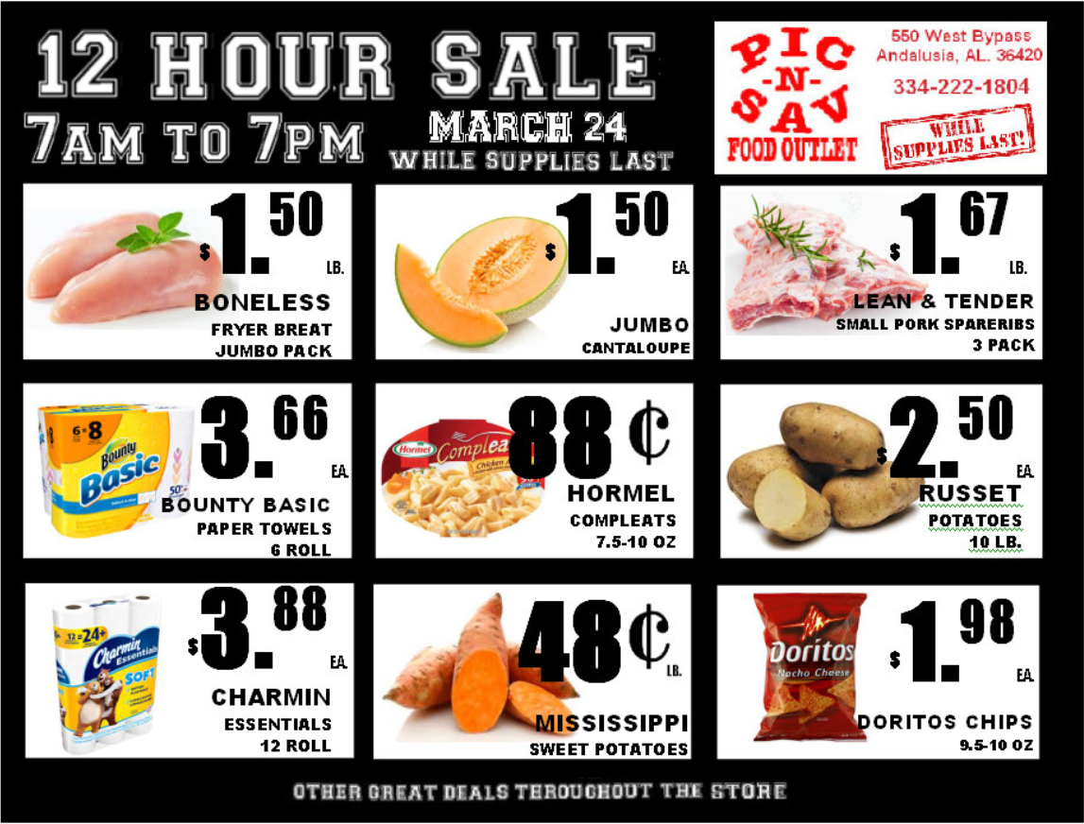
Food Giant Flyer Example
Notes:
Food Giant is a much smaller company than a large grocery store chain like Publix, and lacks a consistent flyer design
This is one of the official Food Giant Flyers.
This is designed by a single person in the corporate office
As you can see, it’s pretty basic compared to something like Publix
It looks to be manually assembled in paint or word, you can see a Green Underline over the Russet Potatoes
Some of the lettering isn’t lined up
After seeing that these are the standard flyers for the store, I feel like I can at least generate this kind of Flyer Programmatically, even with my limited design skills

Slide 5
Initial Steps
Thought About Requirements
Refined Project Definition
Discussed what program should do with client
Notes:
First, I just wrote down thoughts on what I think the project should do
While I was doing that, I worked on the Project Definition like everyone else to better understand the objective and requirements of the project
I talked with my client once I organized a step by step process of what the project should do and how it fits into the overall store work flow
I tried to think about how you could create a page programmatically that would look similar or better than the flyer I just showed
I know it’s easy to create a template file in something like word that can be manually edited, but it needs to be done via a program to eliminate the chance of user error and simplify the process to where anyone can do it
This is even more important given the User Base, which is why I mentioned the UI’s ease of use as a requirement in my SRS
The client had informed me that the managers using the product may have very little computer experience.
And like most programs, there will be a varied user base.
I cannot trust the user to know exactly what input they need to enter or even to enter it correctly.
This eliminated the possibility of a simple template file satisfying the requirements
This is what really allowed me to say that this project could be complex enough to work on for a Capstone

Slide 6
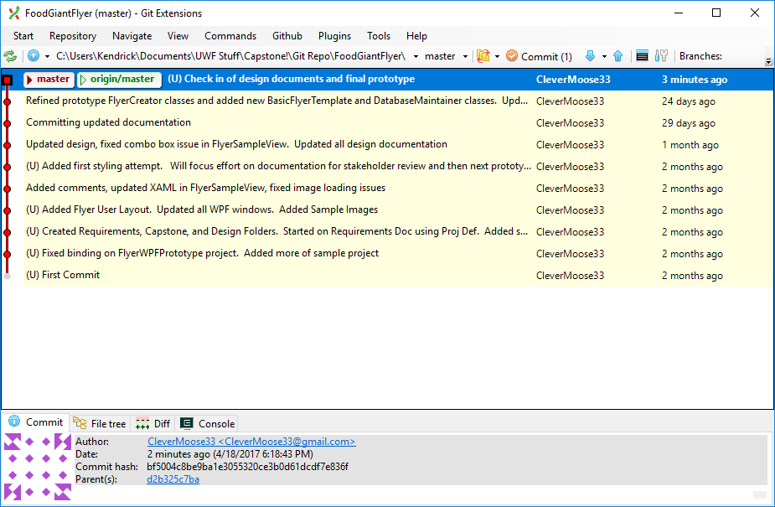

Beginning of Design
Started Initial Design
Wrote Research Paper
Created Git Repository
Notes:
So, after completing the initial few sections of the definition, I started my research paper and design documents
During my discussion with the client, I found that all the store computers at each store use desktop Windows
Some are running outdated versions of XP and some are running Windows 10, so I have a broad list of machine requirements
However, they are all in Windows, and there are no plans to run Mac on Food Giant machines, so that eliminated a requirements to make the program cross-platform
I wanted to use a language that makes it easy to quickly generate and edit user interfaces, and I’m more familiar with C# than Java.
Java is much easier to write cross-platform applications for, but C# can still be cross platform through Xamarin, which can allow C# applications to run through Android or iOS
But since this is not a requirement, I decided on C#
Also, due to the varied amount of machine configurations, my client and I decided on hosting the application on a server for now.
This mitigated the biggest risk, which is the Managers’ machines
Next I continued research into how I should design my application
Since I’m using C#, I wanted to use Extensible Application Markup Language or XAML
XAML is a more modern design language that we’re starting to use at work, so I had an interest to learn more about XAML by using it in my program
XAML also helps make the GUI much more customizable over Win Forms
Next, I decided on Model View View-Model Pattern – Reference https://msdn.microsoft.com/en-us/library/hh848246.aspx
I like separating my logic out of my design components, so MVVM was an easy choice
I also decided to use Caliburn Micro – Reference http://caliburnmicro.com/
CM helps to let me quickly set up MVVM layouts without creating excessive lines of code, and has an open license, so I can use it for this application without future legal issues
I will show how XAML, MVVM and Caliburn work together in my prototype application in my YouTube Presentation when I demonstrate my prototype application
We’re currently going to use Microsoft Azure to host the program so stores can start testing it out and giving us feedback.
It’s important to see how this program works small scale and see if it actually saves the company money before deploying it to the entire company
Finally, I created a Git Repository because I’m paranoid
But seriously, I think Source Control is mandatory for developing any application that’s going to take more than a few days
It also helps remind me of what I was doing when I talk a few days off from it
I’ll be detailing how I plan to use Git in my YouTube presentation. This picture is from Git Extensions, a shell extension for Git

Slide 7
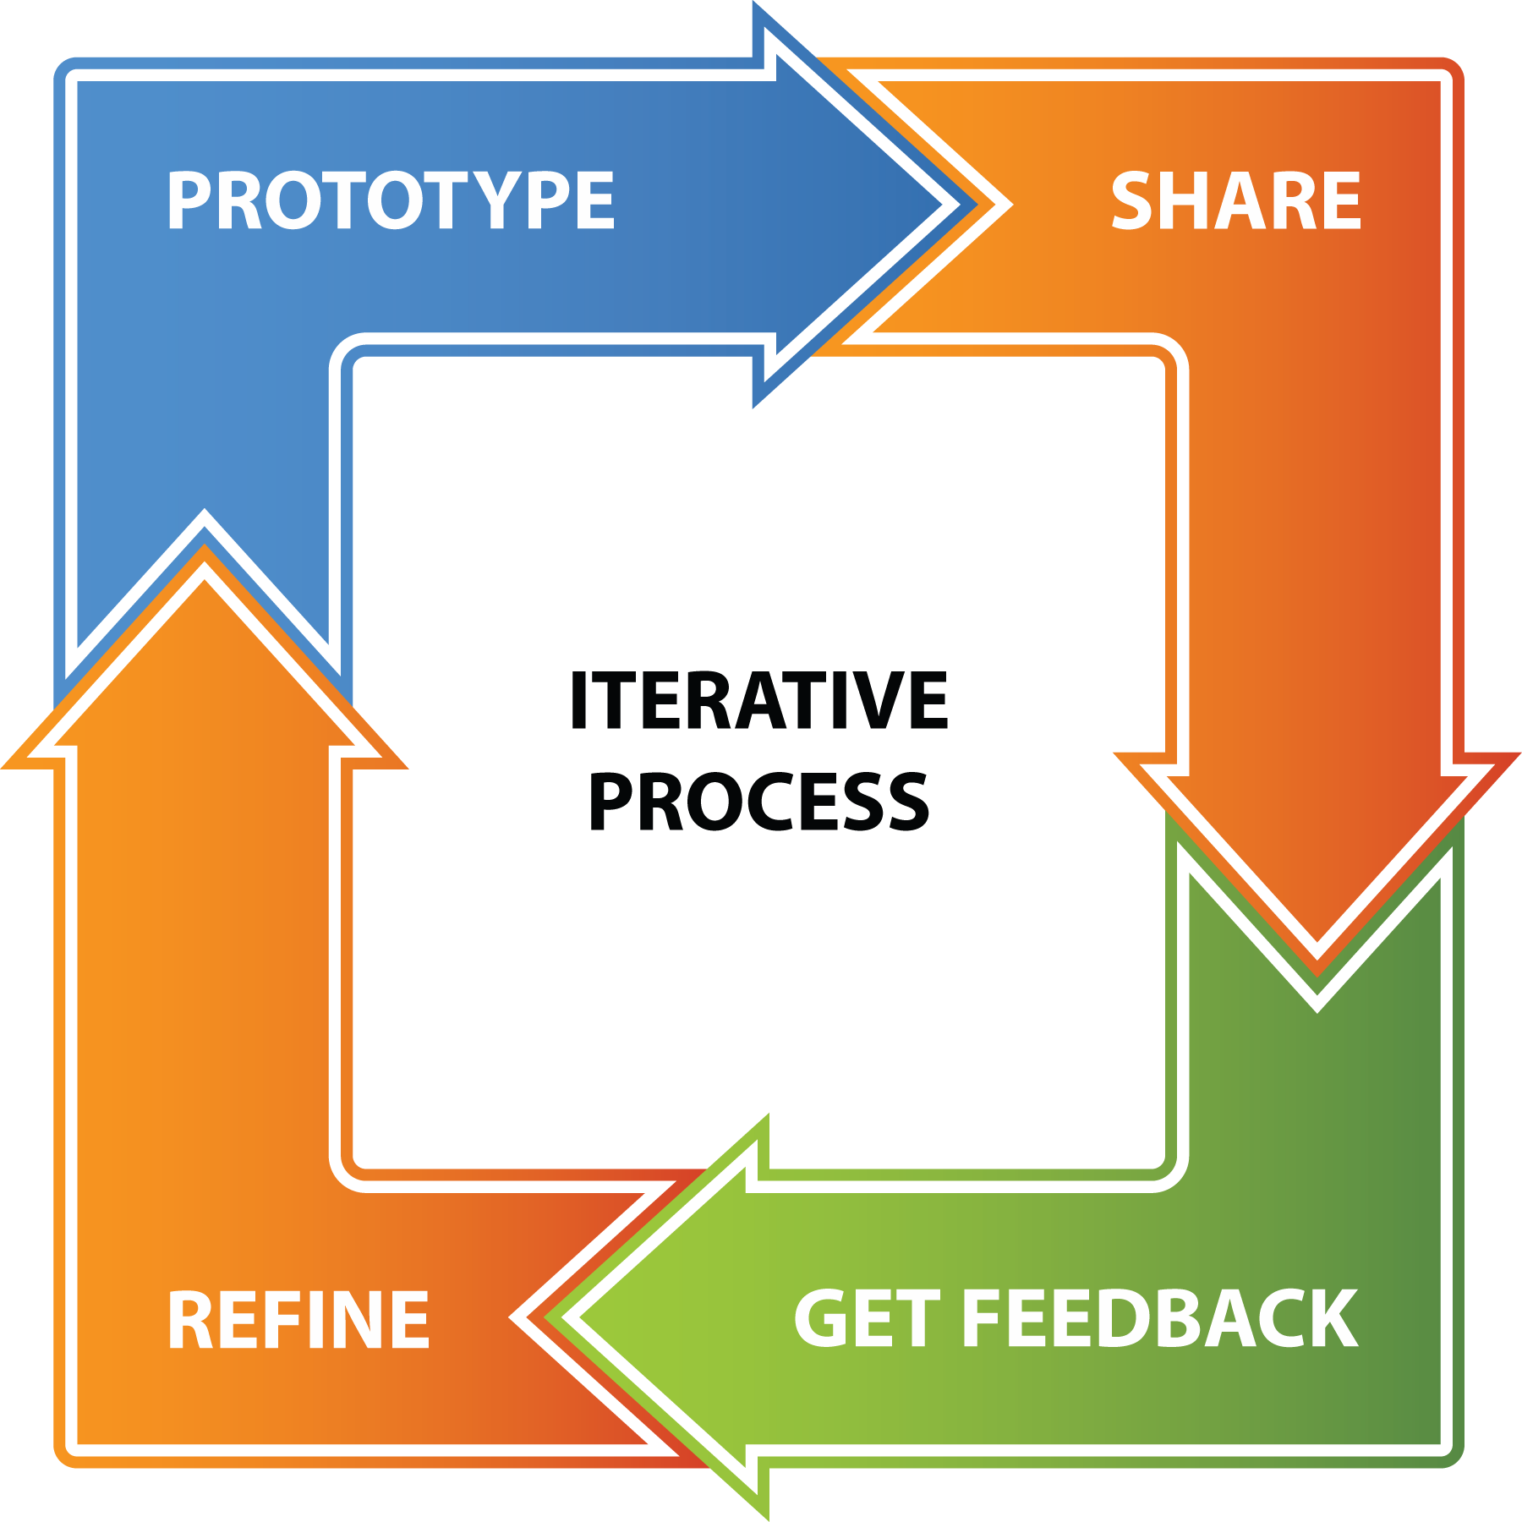

Refinement of Design
Work on Documents
Update Prototype
Repeat.
Notes:
I started with wanting to use an ASP page to populate my flyer, but I eventually removed it.
I decided I wanted to keep the amount of languages in this at a minimum, since others may end up working on this, and I want to keep the application as simple as possible
I needed a database to store all the data for the flyer, and decided on a SQL database, since it’s the industry standard and can be managed in Visual Studio
So, I continued developing my Software Design Document (SDD), Software Product Management Plan (SPMP), Schedule, Coding Standards Document, Software Test Document (STD), Risk Management Document and my Software Requirement Specification (SRS)
I started my prototype early on as well, since my client is not very experienced with computers either, and I felt like having him see what my design idea were early on will help him to list requirements for the program
I feel like this was a great plan, every prototype and discussion got us closer and closer to the (hopefully) final SRS requirements
In actuality, this wasn’t an infinite process, it was an iterative process

Slide 8
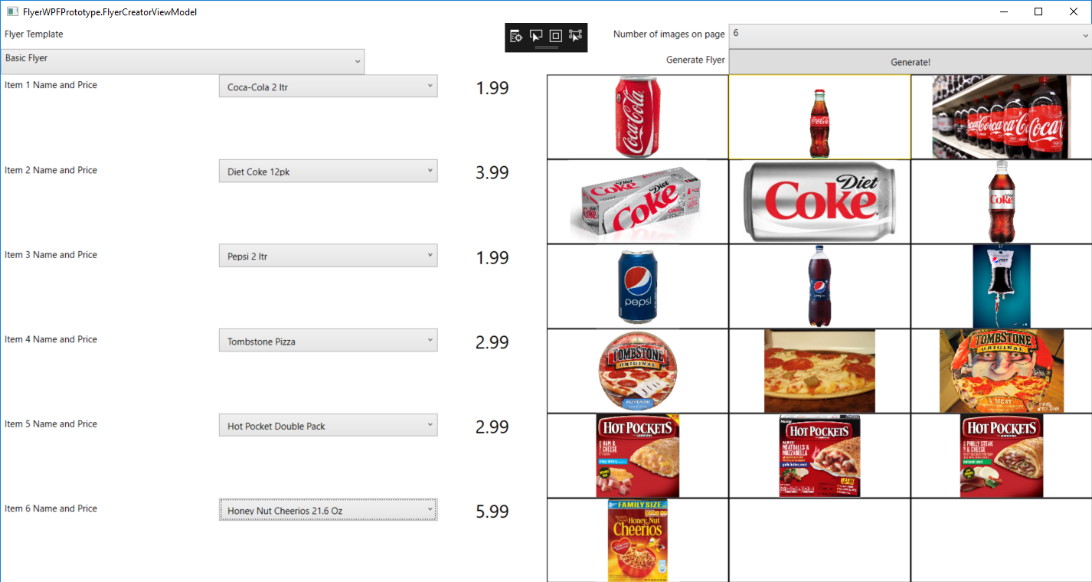
Prototype Picture
Notes:
So, here’s a picture of my flyer creation form in the prototype
As you can see, it’s not pretty yet.
This prototype wasn’t much more than verifying C#, MVVM and Caliburn would all play well together and allow me to confirm that I can implement my design as I expect
It’s a throwaway UI, in that I am not going to use it in any form for the full program
The way the project will be used will be as follows
A store manager logs onto a virtual machine and enters in their user name and password via standard windows authentication services
A flyer creator page will display (a better looking version of this one)
The manager will enter in the flyer type the wish to use
The number of items to generate
Then they will select an item from a drop down box, which is populated from the SQL database, enter the item’s price, item size, and any miscellaneous notes then and select an image for the flyer to display
The generate button will send all of this data to a flyer template to be populated into a flyer that the user can print to a PDF or directly to paper

Slide 9
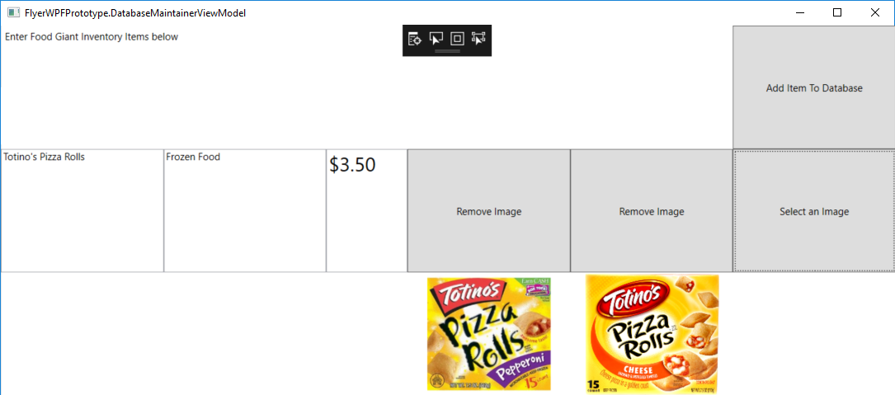
Database Layout Picture
Notes:
And here’s a picture of my GUI that lets the user add data to the database
Again, it’s not pretty, but was designed to show my client what options the user would have
Go through prototype functions and how they relate to design documents
This program is only accessible by district managers or whomever the put in charge of maintaining the database
The user will enter an item name, category and up to 3 images
Then the user clicks add item to database, and will get a confirmation message informing them the item was added successfully, or if they missed an option, like not adding an image
My client decided that the district managers don’t need to be able to enter a price field into the database, and the store managers need a item size value in the previous Flyer Creator Window, so I was glad I got us to talk about this early on
I didn’t go back to update the prototype, which is why you see the price field still there, like I said earlier, this is a throwaway UI
The category field is to potentially add a sorting feature to the creator program that would be needed if the program takes off and ends up getting populated by 100s of items
It would just be adding another field to the flyer creator, like cereals – honey nut cheerios
This isn’t a requirement for this project, because I didn’t think there was enough time to add in a sorting feature, and I feel like that can be worked on if the program actually becomes something the chain wants to use
I’m trying to avoid requirements creep for the project because I’m limited on hours I can work on this

Slide 10
Summary
Notes:
So, in conclusion, I’ve explained my client’s problem domain and the steps I did to understand how I could help solve it
I explained my initial steps in forming requirements and a design
I outlined how my design progress and what technologies and tools I decided on
I showed how I developed and refined my requirements though an iterative process
And I gave a brief demo showing off my less than attractive prototypes that were used to help elicit requirements from the client
I think this application should help Food Giant use more modern ways to sale products
Maybe a future option could be sending the completed flyers to subscribing customers’ smart phones, just a thought
Overall, I feel pretty good about my design, but I guess the only way to know my design was correct is to see if my implementation, testing and deployment phases succeed
Here’s hoping.
Thank you.

